Slide 1
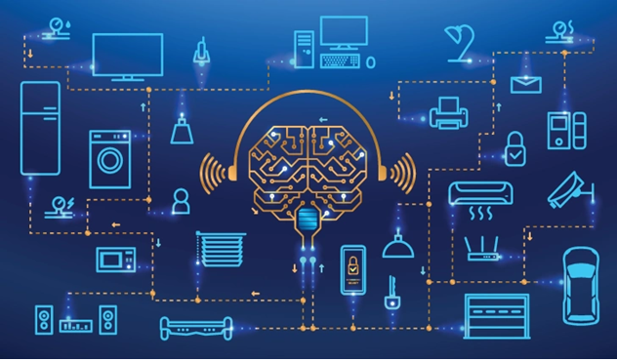
Chapter 4:Internets of Things (IoT)

Slide 2
Content Outline:
4.1. Overview of IoT
4.2. How does it work?
4.3. IoT Tools and Platforms

Slide 3
Chapter Objectives:
After accomplishing this chapter, Students will be able to:
Describe IoT
Explain the history of IoT
Describe the pros and cons of IoT
Explain how IoT works
Explain the architecture of IoT
Describe IoT tools and platforms
Describe some of the application areas of IoT

Slide 4
4.1. Overview of IoT
IoT features includes:-
Artificial Intelligence
Makes virtually anything “smart”.
Connectivity:
IoT creates small but practical networks that no longer tied to major providers between its system devices.
Sensors :
IoT loses its distinction without sensors
makes IoT an active system capable of real-world integration

Slide 5
Active engagement
IoT introduces a new paradigm for active content, product, or service engagement.
small device use
IoT exploits purpose-built small devices to deliver its precision, scalability, and versatility

Slide 6
4.1.1. What is IoT?
IoT is the networking of smart objects
------ Internet Architecture Board’s (IAB)
IoT is the networking of smart objects in which smart objects have some constraints such as limited bandwidth, power, and processing accessibility for achieving interoperability among smart objects.
------ Internet Engineering Task Force (IETF)

Slide 7
Cont’d…
IoT is a framework of all things that have a representation in the presence of the internet in such a way that new applications and services enable the interaction in the physical and virtual world in the form of Machine-to-Machine (M2M) communication in the cloud.
----Institute of Electrical and Electronics Engineers (IEEE)

Slide 8
IoT is the interaction of everyday object’s computing devices through the Internet that enables the sending and receiving of useful data.
----Oxford dictionary’s definition
IoT is expressed through a simple formula such as:
IoT= Services+ Data+ Networks + Sensors
-------IoT in 2020

Slide 9
Cont’d…
Generally IoT is the network of physical objects or "things" embedded with electronics, software, sensors, and network connectivity, which enables objects to collect and exchange data.
It is a network of devices that can sense, accumulate and transfer data over the internet without any human intervention.
It consists of any device with an on/off switch connected to the Internet
Applications: smart-city, smart-home, smart-energy, connected car, smart agriculture, health care, logistics, connected campus, building & industry etc.
Notes:
IoT systems allow users to achieve deeper automation, analysis, and integration within a system. They improve the reach of these areas and their accuracy.

Slide 10
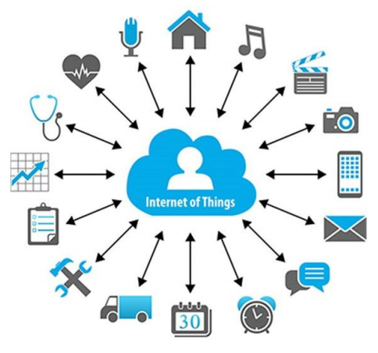
Figure 4.1:- IoT domains

Slide 11
4.1.3. IoT − Advantages
Improved Customer Engagement
Technology Optimization
Reduced Waste
Enhanced Data Collection
4.1.4. IoT – Disadvantages
Lack of Security.
A bug in the system, could affect all connected device

Slide 12
No international standard of compatibility for IoT,
Heterogeneous devices couldn’t make communication.
Collecting and managing the data from millions of IoT devices will be challenging for a given Enterprise.
Notes:
As the number of connected devices increases and more information is shared between devices, the potential that a hacker could steal confidential information also increases.
If there’s a bug in the system, it’s likely that every connected device will become corrupted.
Since there’s no international standard of compatibility for IoT, it’s difficult for devices from different manufacturers to communicate with each other.
Enterprises may eventually have to deal with massive numbers maybe even millions of IoT devices and collecting and managing the data from all those devices will be challenging.

Slide 13
4.1.5. Challenges of IoT
Security
Privacy
Complexity
Flexibility
Compliance

Slide 14
4.2. How does it work?
Sensors
→Collecting, sending, acting on the data they acquire
→Share the data through gateway or cloud to be analyzed locally
IoT Gateway
→Gateway to Internet
→Bridge internal Network to external network
Cloud/server
→is a back bone of IoT
IPV6
End-User Mobile apps
→Data is stored and processed securely using Big data analytics
→Help user to control & command their devices ranging from room thermostat to jet engines & assembly lines

Slide 15
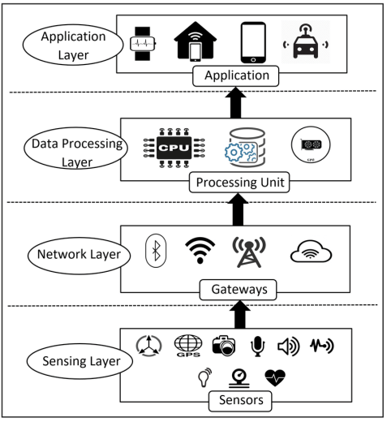
4.2.1. Architecture of IoT
Sensing Layer
Network Layer
Data Processing Layer
Application Layer
Notes:
For instance, environment sensors are used in many applications to improve user experience (e.g., home automation systems, smart locks, smart lights, etc.).

Slide 16
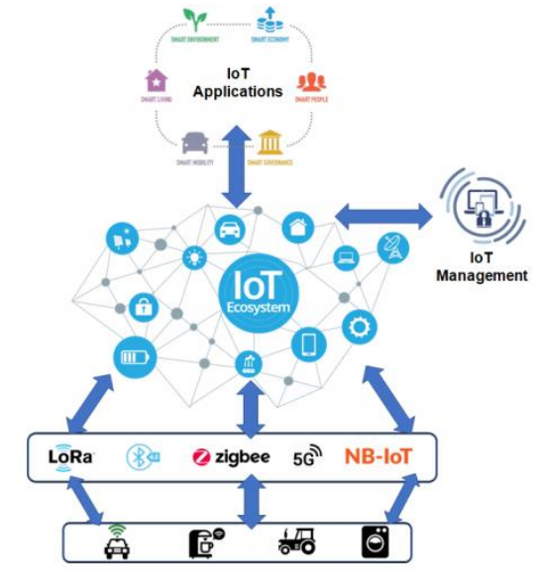
4.2.2. Devices and Networks
Devices can be categorized into three main groups:
Consumer
Enterprise
Industrial
Notes:
In the enterprise, smart sensors
located in a conference room can help an employee locate and schedule an available ro om for a meeting, ensuring the proper room type, size and features are available
When meeting attendees
enter the room, the temperature will adjust according to the occupancy, and the lights will dim as the appropriate PowerPoint loads on the screen and the speaker begins his presentation.

Slide 17
Cont’d…
IoT network devices has constrained resources (power, processing, memory, etc.)
The IoT network devices must be managed, configured and monitored remotely to ensure their correct functioning.
IoT network and device management solution should consider several elements

Slide 18
4.3. IoT Tools and Platforms
KAA
Key Features:
Manage an unlimited number of connected devices
Set up cross-device interoperability
Perform real-time device monitoring
Perform remote device provisioning & configuration
Collect and analyze sensor data
Analyze user behavior and deliver targeted notifications
Create cloud services for smart products

Slide 19
Site
Where
Key Features:
Run any number of IoT applications on a single SiteWhere instance
Spring delivers the core configuration framework
Add devices through self-registration
Integrates with third-party integration frameworks such as Mule any point
Default database storage is MongoDB
Eclipse Californium for CoAP messaging
InfluxDB for event data storage
Grafana to visualize SiteWhere data

Slide 20
Thing
Speak
Key Features:
Collect data in private channels
Share data with public channels
MATLAB analytics and visualizations
Alerts
Event scheduling
App integrations
Worldwide community

Slide 21
Device
Hive
Key Features:
Directly integrate with Alexa
Visualization dashboard of your choice
It supports Big data solutions such as Elastic Search, Apache Spark, Cassandra and Kafka for real-time and batch processing.
Connect any device
It comes with Apache Spark and Spark Streaming support.
Supports libraries written in various programming languages, including Android and iOS libraries
It allows running batch analytics and machine learning on top of your device data

Slide 22
Zetta
Things
Board
Key Features:
Supports a wide range of hacker boards
Zetta allows you to assemble smartphone apps, device apps, and cloud apps
Key Features:
Real-time data visualization and remote device control
Customizable rules, plugins, widgets and transport implementations 76
Allows monitoring client-side and provision server-side device attributes.
Support multi-tenant installations out-of-the-box.
Supports transport encryption for both MQTT & HTTP(s) protocols.

Slide 23
4.4. Applications of IoT
IoT is applicable in sectors :
Agriculture
Consumer Use
Healthcare
Insurance
Manufacturing
Retail
Transportation
Utilities
Notes:
"The Ultimate Goal of IOT is to Automate Human Life."

Slide 24
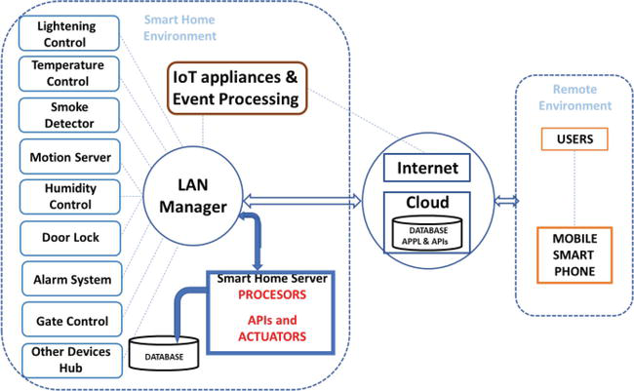
4.3.1. IoT Based Smart Home
Remote Control Appliances
Weather Controlling
Smart Home Appliances
Energy and Water Use
Intrusion Detection Systems
Safety Monitoring

Slide 25
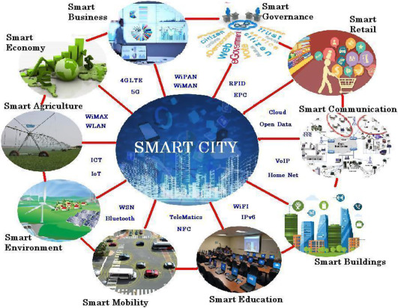
4.3.2. IoT Based Smart City
Structural Health
Lightning
Safety
Transportation
Waste Management
Smart Parking
Img src: Google image

Slide 26
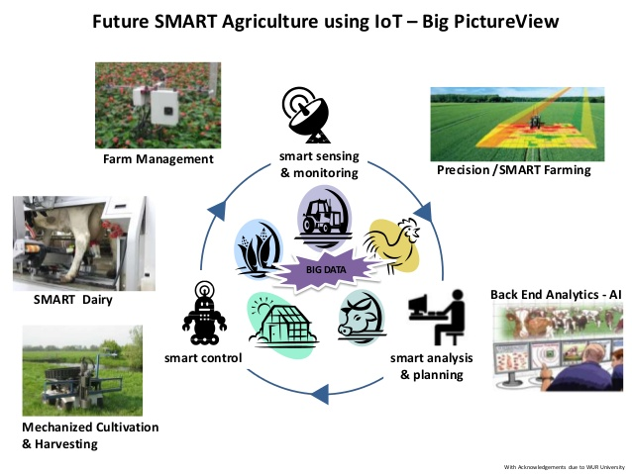
4.3.3. IoT Based Smart Farming
Green Houses
Compost
Animal Farming/Tracking
Offspring Care
Field Monitoring

Slide 27

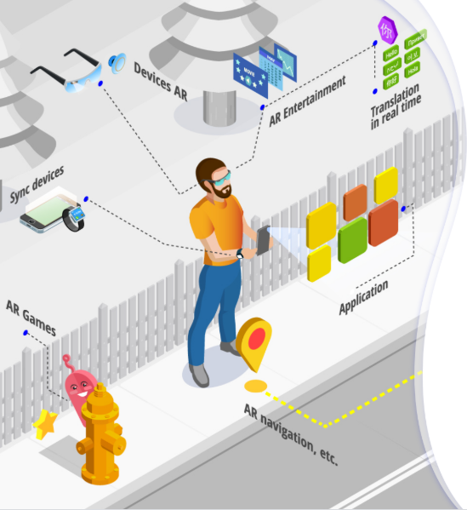
Chapter 5: Augmented Reality(AR)

Slide 28
Content outlines:
Overview of Augmented Reality.
The difference between VR,AR and MR
Architecture of AR systems
Application of AR systems

Slide 29
Chapter Objectives:
After accomplishing this chapter, Students will be able to:
Explain augmented reality
Explain the features of augmented reality
Explain the difference between AR, VR, and MR
Explain the architecture of augmented reality systems
Describe the application areas of augmented reality

Slide 30
Brainstorming
What do you think about Augmented Reality?
What are the common features of Augmented reality?

Slide 31
The fundamental idea of AR is to combine , or mix, the view of the real environment with additional, virtual content that is presented through computer graphics.
Its convincing effect is achieved by ensuring that the virtual content is aligned and registered with the real objects.
As a person moves in an environment and their perspective view of real objects changes, the virtual content should also be presented from the same perspective.

Slide 32
What is Augmented reality(AR)?
Definition
Augmented reality (AR) is a form of emerging technology that allows users to overlay computer generated content in the real world.
AR refers to a live view of a physical real-world environment whose elements are merged with augmented computer-generated images creating a mixed reality.

Slide 33
Augmented Reality (AR) as a real-time direct or indirect view of a physical real-world environment that has been enhanced /augmented by adding virtual computer-generated information to it.
Augmented reality is the integration of digital information with the user's environment in real time.

Slide 34
Virtual Reality (VR)
Virtual Reality (VR) is fully immersive, which tricks your senses into thinking you’re in a different environment or world apart from the real world.
Using a head-mounted display (HMD) or headset, you’ll experience a computer-generated world of imagery and sounds. you can manipulate objects and move around using haptic controllers while tethered to a console or PC.
It is also called a computer-simulated reality.

Slide 35
It refers to computer technologies using reality headsets to generate realistic sounds, images and other sensations that replicate a real environment or create an imaginary world.
Advanced VR environment will engage all five senses (taste, sight, smell, touch, sound) .
Using VR devices such as HTC Vive, Oculus Rift or Google Cardboard, users can be transported into a number of real-world and imagined environments.

Slide 36
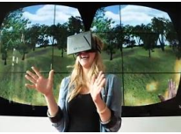
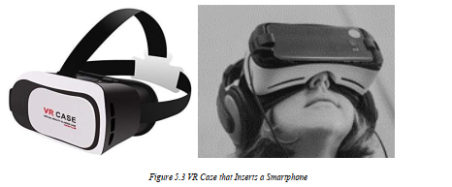

Slide 37
Most VR headsets are connected to a computer (Oculus Rift) or a gaming console (PlayStation VR)
There are standalone devices (Google Cardboard is among the most popular) as well.
Most standalone VR headsets work in combination with smartphones – you insert a smartphone, wear a headset, and immerse in the virtual reality

Slide 38
Augmented Reality (AR)
In augmented reality, users see and interact with the real world while digital content is added to it.
There’s a different way to experience augmented reality, though – with special AR headsets, such as
Google Glass, where digital content is displayed on a tiny screen in front of a user’s eye.
AR adds digital elements to a live view often by using the camera on a smartphone.
Examples of augmented reality experiences include Snapchat lenses and the game Pokémon Go.

Slide 39
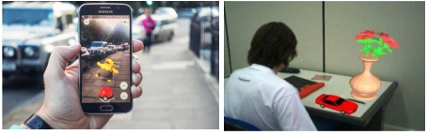
Augmented Reality (AR) is a live, direct or indirect view of a physical, real-world environment whose elements are augmented (or supplemented) by computer-generated sensory input such as sound, video, graphics or GPS data.

Slide 40
Mixed Reality (MR)
Mixed Reality (MR) sometimes referred to as hybrid reality.
It is the merging of real and virtual worlds to produce new environments and visualizations where physical and digital objects co-exist and interact in real-time.
For example, with MR, you can play a virtual video game, grab your real-world water bottle, and smack an imaginary character from the game with the bottle.
Imagination and reality have never been so intermingled.

Slide 41
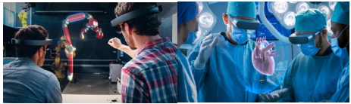
In mixed reality, you interact with and manipulate both physical and virtual items and environments, using next-generation sensing and imaging technologies.

Slide 42
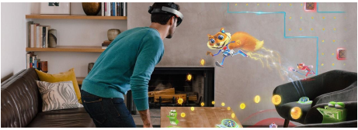
MR allows you to see and immerse yourself in the world around you even as you interact with a virtual environment using your own hands.

Slide 43
VR Vs. AR Vs. MR
The hardware requirements VR is content which is 100% digital and can be enjoyed in a fully immersive environment
AR overlays digital content on top of the real-world.
MR is a digital overlay that allows interactive virtual elements to integrate and interact with the real-world environment.

Slide 44
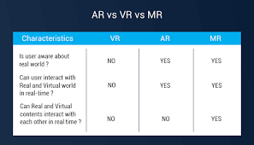

Slide 45
Numerous augmented reality apps and games can run on almost every smartphone on the market.
virtual reality programs require specialized VR headsets, noise-canceling headphones, cameras to track room space and boundaries, and sometimes even motion capture technology.
Some of the biggest names in VR tech today are the Oculus Rift, HTC Vive, and PlayStation VR.
For the enjoyment of simple VR videos, there are affordable makeshift VR headsets like the Google Cardboard.

Slide 46
Mixed reality hardware is still emerging and hasn’t quite broken into the mainstream consumer market, most likely due to the price.
The consumer releases of the Microsoft HoloLens and Magic Leap One retail for over $2000 USD .
However, mixed reality applications sometimes require exponentially more processing power and thus require more powerful hardware.

Slide 47
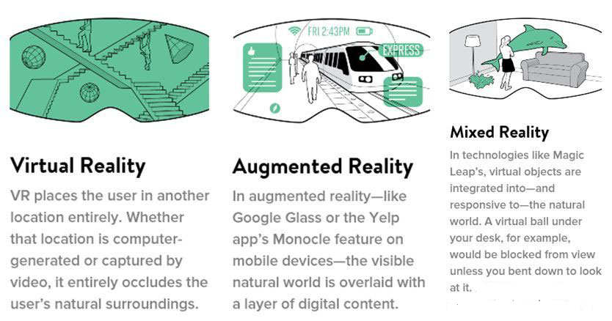

Slide 48
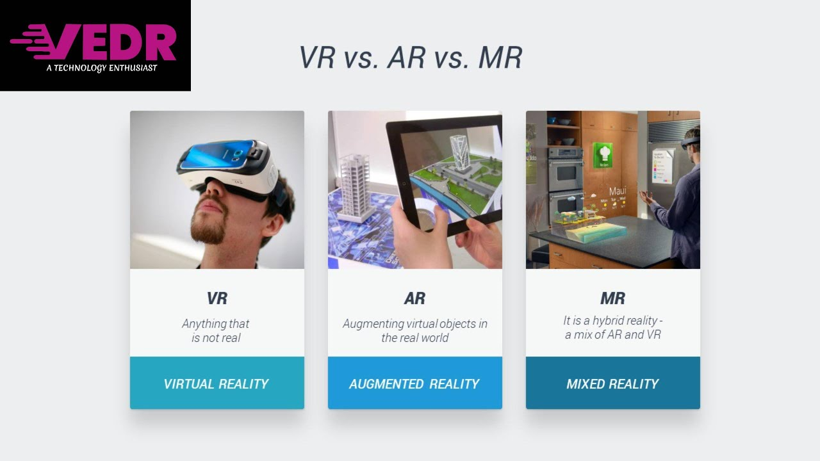

Slide 49
The Microsoft HoloLens includes:
A built-in microphone array,
Binaural sound capabilities,
A built-in camera for recording,
A depth sensor,
Head-tracking cameras,
An inertial measurement unit which helps track head movement

Slide 50
The architecture of AR Systems
The first Augmented Reality Systems (ARS) were usually designed with a basis on three main blocks
Infrastructure Tracker Unit,
Processing Unit, and
Visual Unit.

Slide 51
The Infrastructure Tracker Unit
It is responsible for collecting data from the real world, sending them to the Processing Unit,
Processing Unit
Which mixed the virtual content with the real content and sent the result to the Video Out module of the Visual Unit
Visual Unit
Used to display

Slide 52
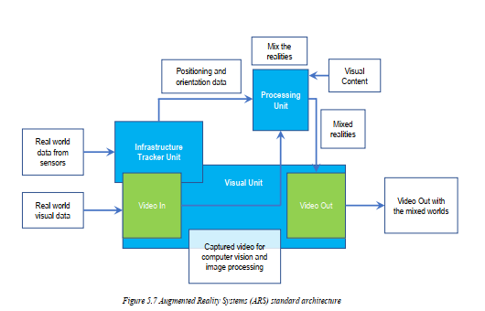
Some designs used a Video In, to acquire required data for the Infrastructure Tracker Unit .

Slide 53
The Visual Unit can be classified into two types of system, depending on the followed visualization technology:
Video see-through
It uses a Head-Mounted Display (HMD) that employs a video-mixing and displays the merged images on a closed-view HMD.
Optical see-through:
It uses an HMD that employs optical combiners to merge the images within an open-view HMD.

Slide 54
HMDs shortcomings
HMDs are currently the dominant display technology in the AR field.
However, they lack in several aspects, such as ergonomics, high prices and relatively low mobility due to their sizes and connectivity features.
An additional problem involving HMD is the interaction with the real environment, which places virtual interactive zones to the user, making the collision with these zones hard due to the difficulty to interact with multiple points in different depths.

Slide 55
Applications of AR Systems
Technology is ever-changing and ever-growing.
One of the newest developing technologies is augmented reality (AR), which can be applied to many different disciplines such as
Education.
Medicine.
Entertainment.
Military, etc.

Slide 56
AR In education
Augmented reality allows flexibility in use that is attractive to education.
AR technology can be utilized through a variety of mediums including desktops, mobile devices, and smartphones.
AR can be used to enhance content and instruction within the traditional classroom,
supplement instruction in the special education classroom, extend content into the world outside the classroom,

Slide 57
More importantly, the following reasons for using augmented reality in education:
Affordable learning materials
Interactive lessons
Higher engagement
Higher retention
Boost intellectual curiosity

Slide 58
AR In Medicine
Augmented reality has the potential to play a big role in improving the healthcare industry.
This new technology is enhancing medicine and healthcare towards more safety and efficiency.
For now, augmented reality has already made significant changes in the following medical areas:
Surgery(minimally invasive surgery);
Education of future doctors;
Diagnostics;

Slide 59
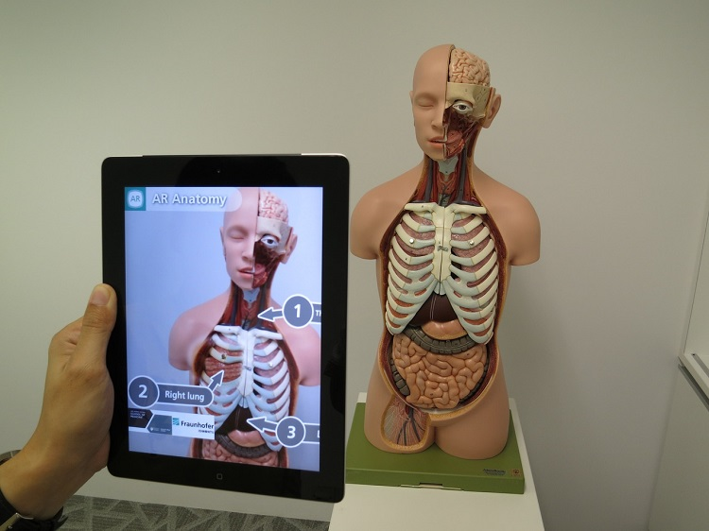
AR in health care

Slide 60
AR tools aid to detect the signs of depression and other mental illnesses by reading from
Facial expressions.
Voice tones.
Physical gestures

Slide 61
In medicine, AR has the following applications:
Describing symptoms
Nursing care
Surgery
Ultrasounds
Diabetes management
Navigation

Slide 62
Generally, AR provides the following benefits to patients and healthcare workers:
Reduce the risks associated with minimally invasive surgery.
Better informed decisions about the right treatment and illness prevention.
Make procedures more tolerable.
Better aftercare
Medical training and education.
Assistance in medical procedures and routine tasks.

Slide 63
AR In Entertainment
AR in games :- such as Pokémon Go
AR in music
AR on TV
AR in eSports
AR in the theater

Slide 64
Review Questions
1. what is augmented, virtual and mixed reality and its application?
2. what are good examples of augmented, virtual and mixed reality?
3. what is the difference between augmented, virtual and mixed reality?
4. How is augmented, virtual and mixed reality achieved? 5. What is the benefit of augmented, virtual and mixed reality?

Slide 65
6. How Can AR, VR, and MR improve engineering instructions?
7. Can VR be a substitute for Real Life Experience? 8. What is the impact of VR on Educational Learning rather than games?
9. What is the most technical challenge for MR?

Slide 66
CHAPTER 6:- ETHICS AND PROFESSIONALISM OF EMERGING TECHNOLOGIES
Objectives of the chapters:
Distinguish the link between ethics and technology.
Understand general, professional and leadership ethical questions.
Explain what digital privacy is, its components and why it is important.
Know the importance of accountability and trust in emerging technologies.
Identify the threats and challenges we face in developing
and utilizing emerging technologies.

Slide 67
6.2. New ethical questions
6.1. Technology and ethics
Activity 6.1
From your civic and ethical education course, what do you understand about the word ethics?

Slide 68
6.1 Technology and ethics
Importance of Internet as a technology:
Provide new tools and new ways for people to interact.
However brought a drawback Like:
New concerns about privacy,
spam and viruses,
Digital divide across the universe.
This takes us to the point that technology can promote or restrict the human right.

Slide 69
6.1 Technology and ethics
For the Information Society, the concerns lies on how to maximize the benefits while minimizing the harms in using ET.
The compelling solution is to set up a proper legal or regulatory system for enhanced gain of benefits for the larger mass, that generally takes us to Ethical values.

Slide 70
6.1 Technology and ethics
Ethics has become a crucial aspect of professional accountability with the inclusion of five basic principles
Integrity
Objectivity
Competence and due care.
Confidentiality, and
Professional behavior.
However, the emergence of new technologies raises
some new challenges for the profession to address.

Slide 71
6.2. New ethical questions
6.2. New ethical questions
Activity 6.2
What do you think the need for ethics in data science? Is it really important to include ethical rules when dealing with big data? If your answer is yes, why?

Slide 72
The increasing use of
Big data.
Algorithmic decision-making, and
Artificial intelligence can enable more
consistent. ,
evidence-based and
accurate judgments or decisions.
Nevertheless the concern still remains how we could possibly and ethically use the emerging new technologies.

Slide 73
The concern here is:- If we deal with biased data, or data based on personal preferences and activities, we would come up with biased and discriminatory result that might intern lead to unfair and unethical out come.
Activity 6.3
What do you think the need for ethics in data science? Is it really important to include ethical rules when dealing with big data? If your answer is yes, why?

Slide 74
6.2. New ethical questions
On the contrary, Whatever the power of the machine, we should also never undermine the role of human judgment or his impact on the ultimate decision its explanation.
Activity 6.4
Do you think that integrating ethical rules with emerging technologies is important? If your answer is yes, why? What are the challenges of integrating ethical rules with the new technologies?

Slide 75
What makes ethics of Technology very difficult is early integration of ethics into the technology life cycle.
the future is un certain.
Ethics has traditionally not been well equipped to deal with issues of uncertainty and, in particular, future uncertainty.

Slide 76
6.2.1. General ethical principles
Activity 6.5
➢ List down common ethical rules that must be applied in all technologies?

Slide 77
6.2.1. General ethical principles
Contribute to society and to human well-being, acknowledging that all people are stakeholders in computing.
Avoid harm.
Be honest and trustworthy.
Be fair and take action not to discriminate.
Respect the work required to produce new ideas, inventions, creative works, and computing artifacts.
Respect privacy.
Honor confidentiality

Slide 78
6.2.2. Professional responsibilities.
Activity 6.6
➢ List down ethical principles related to professional responsibility?

Slide 79
6.2.2. Professional responsibilities.
Strive to achieve high quality in both the processes and products of professional work.
Maintain high standards of professional competence, conduct, and ethical practice.
Know and respect existing rules pertaining to professional work.
Accept and provide appropriate professional review.
Give comprehensive and thorough evaluations of computer systems and their impacts, including analysis of possible risks.
Perform work only in areas of competence.
Foster public awareness and understanding of computing, related technologies, and their consequences.
Access computing and communication resources only when authorized or when compelled by the public good.
Design and implement systems that are robustly and usably secure.

Slide 80
6.2.3. Professional leadership principles.
Activity 6.7
➢ List down ethical principles related to professional leadership?

Slide 81
6.2.3. Professional leadership principles.
1. Ensure that the public good is the central concern during all professional computing work.
2. Articulate, encourage acceptance of and evaluate fulfillment of social responsibilities by members of the organization or group.
3. Manage personnel and resources to enhance the quality of working life.
4. Articulate, apply, and support policies and processes that reflect the principles of the Code.

Slide 82
6.2.3. Professional leadership principles.
5. Create opportunities for members of the organization or group to grow as professionals.
6. Use care when modifying or retiring systems. Interface changes, the removal of features, and even software updates have an impact on the productivity of users and the quality of their work.
7. Recognize and take special care of systems that become integrated into the infrastructure of society.

Slide 83
6.2.3. Professional leadership principles.
Activity 6.7
➢ List down ethical principles related to professional leadership?

Slide 84
6.3. Digital privacy
What do you think about privacy in general? Is it really important?
➢ In this digital world, what do you mean by digital privacy? Give concrete examples?

Slide 85
6.3. Digital privacy
Digital Privacy is the protection of personally identifiable or business identifiable information that is collected from respondents through information collection activities or from other sources.
includes three sub-related categories;
information privacy,
communication privacy, and
individual privacy

Slide 86
6.3.1. Information Privacy
Activity 6.10
➢ What do you think that private information like passwords, PIN numbers, will be guarded or shared with the public? Why?

Slide 87
CHAPTER 7: OTHER EMERGING TECHNOLOGIES
Content Outlines:
Nanotechnology
Biotechnology
Block-chain technology
Cloud and quantum computing
Autonomic computing
Computer vision
Embedded systems,
Cybersecurity and 3D printing.

Slide 88
7.1 Nanotechnology.
Definitions :
Nano-science
As the study of phenomena and manipulation of materials at atomic, molecular and macromolecular scales, where properties differ significantly from those at a larger scale.
Nanotechnologies
As the design, characterization, production, and application of structures, devices, and systems by controlling shape and size at the nanometer scale.

Slide 89
Nanotechnology is science, engineering, and technology conducted at the Nano-scale, which is about 1 to 100 nanometers.
Nano science and nanotechnology are the study and application of extremely small things and can be used across all the other science fields, such as chemistry, biology, physics, materials science, and engineering.

Slide 90
The ideas and concepts behind nanoscience and nanotechnology started with a talk entitled “There’s plenty of room at the bottom” by physicist
Richard Feynman at an American Physical Society meeting at the California Institute of Technology (Caltech) on December 29, 1959, long before the term nanotechnology was used.

Slide 91
He described a process in which scientists would be able to manipulate and control individual atoms and molecules.
Over a decade later, in his explorations of ultraprecision machining,
Professor Norio Taniguchi coined the term nanotechnology.
It wasn't until 1981, with the development of the scanning tunneling microscope that could "see" individual atoms, that modern nanotechnology began.

Slide 92
Fundamental concepts
It’s hard to imagine just how small nanotechnology is.
One nanometer is a billionth of a meter or 10-9 of meters.
For example:
There are 25,400,000 nanometers in an inch.
A sheet of newspaper is about 100,000 nanometers thick.

Slide 93
On a comparative scale, if a marble were a nanometer, then one meter would be the size of the Earth.
Nano science and nanotechnology involve the ability to see and to control individual atoms and molecules.
Everything on Earth is made up of atoms—the food we eat, the clothes we wear, the buildings and houses we live in, and our own bodies.

Slide 94
The microscopes needed to see things at the nanoscale were invented relatively, recently about 30 years ago.
An atom has a diameter of about 0.1 nm. An atom's nucleus is much smaller about 0.00001 nm. Atoms are the building blocks for all matter in our universe.
The properties of materials can be different at the nanoscale for two main reasons:

Slide 95
First,
Nano-materials have a relatively larger surface area when compared to the same mass of material produced in a larger form.
This can make materials more chemically reactive (in some cases materials that are inert in their larger form are reactive when produced in their Nano-scale form), and affect their strength or electrical properties.

Slide 96
Second:
Quantum effects can begin to dominate the behavior of matter at the nanoscale particularly at the lower end – affecting the optical, electrical and magnetic behavior of materials.
Materials can be produced that are nanoscale in one dimension (for example, nanowires, Nano rods, and nanotubes), in two dimensions (plate-like shapes like Nano coating, Nano layers, and graphene) or in all three dimensions (for example, nanoparticles).

Slide 97
Today's scientists and engineers are finding a wide variety of ways to deliberately make materials at the Nano scale to take advantage of their enhanced properties such as higher strength, lighter weight, increased control of light spectrum and greater chemical reactivity than their larger-scale counterparts

Slide 98
7.1.3 Application of Nanotechnology
Medicine: customized nanoparticles the size of molecules that can deliver drugs directly to diseased cells in your body.
Electronics: it has some answers for how we might increase the capabilities of electronics devices while we reduce their weight and power consumption.
Food: it has an impact on several aspects of food science, from how food is grown to how it is packaged.

Slide 99
Agriculture: nanotechnology can possibly change the whole agriculture part and nourishment industry anchor from generation to preservation, handling, bundling, transportation, and even waste treatment.
Vehicle manufacturers: Much like aviation, lighter and stronger materials will be valuable for making vehicles that are both quicker and more secure.

Slide 100
7.2 Biotechnology
Definition:
Biotechnology is a technology based on biology.
It harnesses cellular and biomolecular processes to develop technologies and products that help improve our lives and the health of our planet.
We have used the biological processes of microorganisms for long time to make useful food products, such as bread and cheese, and to preserve dairy products .

Slide 101
Genetic engineering is the process of transferring individual genes between organisms or modifying the genes in an organism to remove or add a desired trait or characteristic.
In modern biotechnology, researchers modify DNA and proteins to shape the capabilities of living cells, plants, and animals into something useful for humans.

Slide 102
Application of biotechnology
Agriculture (Green Biotechnology): Biotechnology had contributed a lot to modify the genes of the organism known as Genetically Modified Organisms such as Crops, Animals, Plants, Fungi, Bacteria, etc. Genetically modified crops are formed by the manipulation of DNA to introduce a new trait into the crops.

Slide 103
Medicine (Medicinal Biotechnology): This helps in the formation of genetically modified insulin known as humulin. This helps in the treatment of a large number of diabetes patients. It has also given rise to a technique known as gene therapy. Gene therapy is a technique to remove the genetic defect in an embryo or child.
Aquaculture Fisheries: It helps in improving the quality and quantity of fishes. Through biotechnology, fishes are induced to breed via gonadotropin-releasing hormone.

Slide 104
Environment (Environmental biotechnology): is used in waste treatment and pollution prevention. Environmental biotechnology can more efficiently clean up many wastes than conventional methods and greatly reduce our dependence on methods for land-based disposal.

Slide 105
7.3.Blockchain technology
A Blockchain is a time-stamped series of immutable records of data that is managed by a cluster of computers not owned by any single entity.
Each of these Blocks of data (i.e. block) is secured and bound to each other using cryptographic principles (i.e. chain).
“Blocks” on the Blockchain are made up of digital pieces of information.

Slide 106
Specifically, they have three parts:
Blocks store information about transactions like the date, time, and dollar amount of your most recent purchase from Amazon.
Blocks store information about who is participating in transactions. A block for your splurge purchase from Amazon would record your name along with Amazon. Instead of using your actual name, your purchase is recorded without any identifying information using a unique “digital signature,” sort of like a username.

Slide 107
Blocks store information that distinguishes them from other blocks. Much like you and I have names to distinguish us from one another, each block stores a unique code called a “hash” that allows us to tell it apart from every other block.

Slide 108
In order for a block to be added to the Blockchain, however, four things must happen:
1. A transaction must occur.
2. That transaction must be verified.
3. That transaction must be stored in a block.
4. That block must be given a hash.

Slide 109
By design, a blockchain is resistant to modification of the data. It is "an open, distributed ledger that can record transactions between two parties efficiently and in a verifiable and permanent way".
The blockchain network has no central authority; it is the very definition of a democratized system. Since it is a shared and immutable ledger, the information in it is open for anyone and everyone to see

Slide 110
The Three Pillars of Blockchain Technology
1. Decentralization:
In a decentralized system the information is not stored by one single entity. In fact, everyone in the network owns the information.
In a decentralized network ,if you wanted to interact with your friend then you can do so directly without going through a third party. That was the main ideology behind Bitcoins.

Slide 111
2. Transparency:
One of the most interesting and misunderstood concepts in blockchain technology is “transparency.” Some people say that blockchain gives you privacy while some say that it is transparent.
A person’s identity is hidden via complex cryptography and represented only by their public address. So, if you were to look up a person’s transaction history, you will not see.

Slide 112
3. Immutability
Immutability, in the context of the blockchain, means that once something has been entered into the blockchain, it cannot be tampered with.
The reason why the blockchain gets this property is that of the cryptographic hash function.

Slide 113
In simple terms, hashing means taking an input string of any length and giving out an output of a fixed length. In the context of crypto currencies like bitcoin, the transactions are taken as input and run through a hashing algorithm (Bitcoin uses SHA-256) which gives an output of a fixed length.

Slide 114
7.3.6. Application of blockchain
The sharing economy
With companies like Uber and Airbnb flourishing, the sharing economy is already a proven success .
B. Crowd funding
Crowd funding initiatives like Kickstarter and GoFundMe are doing the advance work for the emerging peer-to-peer economy.

Slide 115
C. Governance
By making the results fully transparent and publicly accessible, distributed database technology could bring full transparency to elections or any other kind of poll taking.
D. Supply chain auditing
Consumers increasingly want to know that the ethical claims companies make about their products are real. Distributed ledgers provide an easy way to certify that the backstories of the things we buy are genuine.

Slide 116
File storage
Decentralizing file storage on the internet brings clear benefits. Distributing data throughout the network protects files from getting hacked or lost.
Interplanetary File System (IPFS) makes it easy to conceptualize how a distributed web might operate.

Slide 117
7.4.Cloud and quantum computing
Cloud computing is a means of networking remote servers that are hosted on the Internet. Rather than storing and processing data on a local server, or a PC's hard drive, one of the following three types of cloud infrastructure is used .
The first type is a public cloud. Here a third-party provider manages the servers, applications, and storage much like a public utility .

Slide 118
A business or organization would typically use a private cloud. This might be hosted on their on-site data center, although some companies host through a third-party provider instead.
The third option is a hybrid cloud. Here private clouds are connected to public clouds, allowing data and applications to be shared between them.

Slide 119
Advantages of cloud computing
Cheap computing power.
No need for the initial costly capital investment.
Energy costs are shared.
Cloud providers have vast resources of computing power at their fingertips.
Allows you and multiple users to access your data from any location.
Smartphone, laptop, desktop, wherever you are, you can access the data you need at any time.

Slide 120
7.4.3. Quantum computing
Quantum computers truly do represent the next generation of computing. Unlike classic computers, they derive their computing power by harnessing the power of quantum physics.
Currently, the only organization which provides a quantum computer in the cloud is IBM. They allow free access to anyone who wishes to use their 5-qubit machine. Earlier this year they installed a 17-qubit machine.
So far over 40,000 users have taken advantage of their online service to run experiments .

Slide 121
Advantages of quantum computing:
Getting a quantum computer to function usefully is an exciting prospect for scientists.
Their gargantuan computing power would allow them to crunch very long numbers.
They would be able to make complex calculations that would only overwhelm classic computers.

Slide 122
7.5.Autonomic computing (AC)
Autonomic computing (AC) is an approach to address the complexity and evolution problems in software systems.
It is a self-managing computing model named after, and patterned on, the human body's autonomic nervous system.
The goal of autonomic computing is to create systems that run themselves, capable of high-level functioning while keeping the system's complexity invisible to the user.

Slide 123
Characteristics of Autonomic Systems
An autonomic system can self-configure at runtime to meet changing operating environments, self-tune to optimize its performance, self-heal when it encounters unexpected obstacles during its operation, and of particular current interest.
Autonomic systems/applications exhibit eight defining characteristics:

Slide 124
Self-Awareness: An autonomic application/system “knows itself” and is aware of its state and its behaviors.
Self-Configuring: An autonomic application/system should be able to configure and reconfigure itself under varying and unpredictable conditions.
Self-Optimizing: An autonomic application/system should be able to detect suboptimal behaviors and optimize itself to improve its execution.

Slide 125
Self-Healing: An autonomic application/system should be able to detect and recover from potential problems and continue to function smoothly.
Self-Protecting: An autonomic application/system should be capable of detecting and protecting its resources from both internal and external attacks and maintaining overall system security and integrity.

Slide 126
Context-Aware: An autonomic application/system should be aware of its execution environment and be able to react to changes in the environment.
Open: An autonomic application/system must function in a heterogeneous world and should be portable across multiple hardware and software architectures. Consequently, it must be built on standard and open protocols and interfaces.
Anticipatory: An autonomic application/system should be able to anticipate to the extent possible, its needs and behaviors and those of its context, and be able to manage itself proactively.

Slide 127
7.6.Computer vision
Definition :
It is an interdisciplinary scientific field that deals with how computers can be made to gain a high-level understanding of digital images or videos.
Computer vision tasks include methods for acquiring, processing, analyzing and understanding digital images, and extraction of high-dimensional data from the real world in order to produce numerical or symbolic information, e.g. in the forms of decisions

Slide 128
1. Acquiring an image: Images, even large sets, can be acquired in real-time through video, photos or 3D technology for analysis.
2. Processing the image: Deep learning models automate much of this process, but the models are often trained by first being fed thousands of labeled or pre-identified images.
3. Understanding the image: The final step is the interpretative step, where an object is identified or classified.

Slide 129
There are many types of computer vision that are used in different ways:
Image segmentation partitions an image into multiple regions or pieces to be examined separately.
Object detection identifies a specific object in an image. Advanced object detection recognizes many objects in a single image: a football field, an offensive player, a defensive player, a ball and so on. These models use an X, Y coordinate to create a bounding box and identify everything inside the box.

Slide 130
Facial recognition is an advanced type of object detection that not only recognizes a human face in an image but identifies a specific individual.
Edge detection is a technique used to identify the outside edge of an object or landscape to better identify what is in the image.
Pattern detection is a process of recognizing repeated shapes, colors and other visual indicators in images.

Slide 131
Image classification groups images into different categories.
Feature matching is a type of pattern detection that matches similarities in images to help classify them.

Slide 132
Applications of computer vision
Computer vision is being used today in a wide variety of real-world applications, which include:
Optical character recognition (OCR): reading handwritten postal codes on letters and automatic number plate recognition (ANPR);
Machine inspection: rapid parts inspection for quality assurance using stereo vision with specialized illumination to measure tolerances on aircraft wings or auto body parts or looking for defects in steel castings using X-ray vision;

Slide 133
Retail: object recognition for automated checkout lanes
Medical imaging: registering pre-operative and intra-operative imagery or performing long-term studies of people’s brain morphology as they age;
Automotive safety: detecting unexpected obstacles such as pedestrians on the street, under conditions where active vision techniques such as radar or lidar do not work well.
Surveillance: monitoring for intruders, analyzing highway traffic and monitoring pools for drowning victims;
Fingerprint recognition and biometrics: for automatic access authentication as well as forensic applications.

Slide 134
7.7.Embedded systems
It is a controller with a dedicated function within a larger mechanical or electrical system, often with real-time computing constraints. It is embedded as part of a complete device often including hardware and mechanical parts.
Modern embedded systems are often based on microcontrollers (i.e. microprocessors with integrated memory and peripheral interfaces), but ordinary microprocessors (using external chips for memory and peripheral interface circuits) are also common, especially in more complex systems.

Slide 135
Advantages and disadvantages of embedded system
Advantages of Embedded:
Easily Customizable.
Low power consumption.
Low cost.
Enhanced performance
Disadvantages of Embedded systems:
High development effort.
Larger time to market

Slide 136
Basic Structure of an Embedded System:
Sensor − It measures the physical quantity and converts it to an electrical signal which can be read by an observer or by any electronic instrument like an A2D converter. A sensor stores the measured quantity to the memory.
A-D Converter − An analog-to-digital converter converts the analog signal sent by the sensor into a digital signal.

Slide 137
Processor & ASICs − Processors process the data to measure the output and store it to the memory.
D-A Converter − A digital-to-analog converter converts the digital data fed by the processor to analog data.
Actuator − An actuator compares the output given by the D-A Converter to the actual (expected) output stored in it and stores the approved output.

Slide 138
7.8.Cybersecurity
Definition:
It is the protection of computer systems from the theft of or damage to their hardware, software, or electronic data, as well as from the disruption or misdirection of the services they provide.
Cyber security is becoming more important due to
Increased reliance on computer systems.
The Internet and wireless network standards such as Bluetooth and Wi-Fi.and due to the growth of smart devices, including smartphones, televisions, and the various devices that constitute the Internet of Things.

Slide 139
Cybercrime is any criminal activity that involves a computer, network devices or a network.
It is often committed by the people of destructive and criminal mindset either for revenge, greed or adventure.

Slide 140
Cyber security measures
Some of cyber security measures to be taken to prevent cybercrime .
Staff awareness training: - Human error is the leading cause of data breaches, so you need to equip staff with the knowledge to deal with the threats they face.
Application security: - Web application vulnerabilities are a common point of intrusion for cybercriminals. As applications play an increasingly critical role in business, it is vital to focus on web application security.

Slide 141
Network security: - is the process of protecting the usability and integrity of network and data.
This is achieved by conducting a network penetration test, which scans your network for vulnerabilities and security issues .
Leadership commitment: - is the key to cyber resilience. Without it, it is very difficult to establish or enforce effective processes .Top management must be prepared to invest in appropriate cybersecurity resources, such as awareness training.
Password management :-provides guidance to ensure that individuals or organizations create strong passwords and keep them secure .

Slide 142
Types of cyber security threats
Ransomware: - It is a type of malicious software. It is designed to extort money by blocking access to files or the computer system until the ransom is paid. Paying the ransom does not guarantee that the files will be recovered or the system restored.
Malware:- it is a type of software designed to gain unauthorized access or to cause damage to a computer.

Slide 143
Social engineering: - it is a tactic that adversaries use to trick you into revealing sensitive information. They can solicit a monetary payment or gain access to your confidential data.
Phishing: - it is the practice of sending fraudulent emails that resemble emails from reputable sources. The aim is to steal sensitive data like credit card numbers and login information. It’s the most common type of cyber-attack.

Slide 144
Benefits of utilizing cybersecurity include:
Business protection against malware, ransomware, phishing, and social engineering.
Protection for data and networks.
Prevention of unauthorized users.
Improves recovery time after a breach.
Protection for end-users.
Improved confidence in the product for both developers and customers.

Slide 145
Cyber security vendors
Vendors in cybersecurity fields will typically use endpoint, network and advanced threat protection security as well as data loss prevention.
Three commonly known cybersecurity vendors include Cisco, McAfee, and Trend Micro.

Slide 146
7.9.Additive manufacturing (3D Printing)
Let’s start by considering what the experts have to say about AM (3D printing )
The American Society for Testing and Materials (ASTM) equates the two terms in their definition: “Additive manufacturing, also known as 3D printing, uses computer-aided design to build objects layer by layer.”
Wikipedia says, “Today, the precision, repeatability, and material range has increased to the point that 3D printing is considered as industrial production technology, with the name of additive manufacturing.”
Author Deve Turbide puts it simply, suggesting that additive manufacturing is “the industrial version of 3D printing”.

Slide 147
3D Printing: It's All About the Printer
When MIT invented binder jet printing in the 1980s, they wrote: “three-dimensional printing is a process under development at MIT for the rapid and flexible production of prototype parts, end-use parts, and tools directly from a CAD model.”
Today our concept of “3D printing” is much broader, but the term is often associated with filament-based plastic printers .But there are also binder jet printers, laser metal 3D printers, as well as glass and clay 3D printers.

Slide 148
Additive Manufacturing:
“Additive manufacturing” (AM) is a big-picture term more at home in the boardroom than the factory floor or garage. Naturally, AM separates itself from older, subtractive technologies like milling.
Additive manufacturing (AM) describes types of advanced manufacturing that are used to create three-dimensional structures out of plastics, metals, polymers and other materials that can be sprayed through a nozzle or aggregated in a vat .

Slide 149
Thank you

